Slide 1
CHAPTER 6:
INTRODUCTION TO SQL
Modern Database Management
11th Edition
Jeffrey A. Hoffer, V. Ramesh,
Heikki Topi
© 2013 Pearson Education, Inc. Publishing as Prentice Hall

Slide 2
OBJECTIVES
Define terms
Interpret history and role of SQL
Define a database using SQL data definition language
Write single table queries using SQL
Establish referential integrity using SQL
Discuss SQL:1999 and SQL:2008 standards

Slide 3
SQL OVERVIEW
Structured Query Language
The standard for relational database management systems (RDBMS)
RDBMS: A database management system that manages data as a collection of tables in which all relationships are represented by common values in related tables

Slide 4
HISTORY OF SQL
1970–E. F. Codd develops relational database concept
1974-1979–System R with Sequel (later SQL) created at IBM Research Lab
1979–Oracle markets first relational DB with SQL
1981 – SQL/DS first available RDBMS system on DOS/VSE
Others followed: INGRES (1981), IDM (1982), DG/SGL (1984), Sybase (1986)
1986–ANSI SQL standard released
1989, 1992, 1999, 2003, 2006, 2008–Major ANSI standard updates
Current–SQL is supported by most major database vendors

Slide 5
PURPOSE OF SQL STANDARD
Specify syntax/semantics for data definition and manipulation
Define data structures and basic operations
Enable portability of database definition and application modules
Specify minimal (level 1) and complete (level 2) standards
Allow for later growth/enhancement to standard (referential integrity, transaction management, user-defined functions, extended join operations, national character sets)

Slide 6
BENEFITS OF A STANDARDIZED RELATIONAL LANGUAGE
Reduced training costs
Productivity
Application portability
Application longevity
Reduced dependence on a single vendor
Cross-system communication

Slide 7
SQL ENVIRONMENT
Catalog
  A set of schemas that constitute the description of a database
Schema
  The structure that contains descriptions of objects created by a user (base tables, views, constraints)
Data Definition Language (DDL)
  Commands that define a database, including creating, altering, and dropping tables and establishing constraints
Data Manipulation 操纵 Language (DML)
  Commands that maintain and query a database
Data Control Language (DCL)
  Commands that control a database, including administering privileges 特权 and committing data

Slide 8
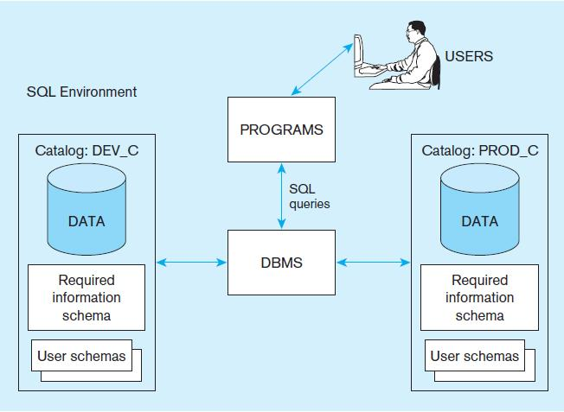
Figure 6-1
A simplified schematic of a typical SQL environment, as described by the SQL: 2008 standard
Chapter 6
© 2013 Pearson Education, Inc. Publishing as Prentice Hall

Slide 9
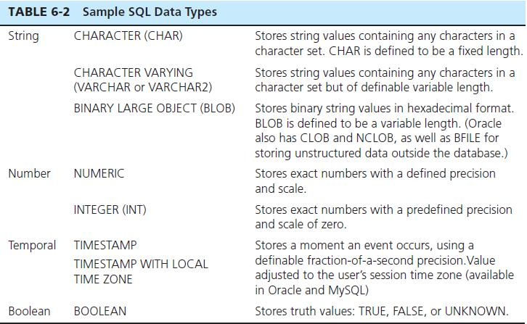
SQL DATA TYPES

Slide 10
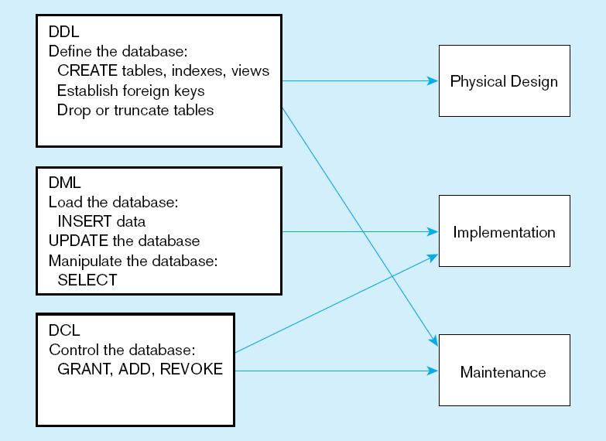
Figure 6-4
DDL, DML, DCL, and the database development process
Chapter 6
© 2013 Pearson Education, Inc. Publishing as Prentice Hall

Slide 11
SQL DATABASE DEFINITION
Data Definition Language (DDL)
Major CREATE statements:
  CREATE SCHEMA–defines a portion of the database owned by a particular user
  CREATE TABLE–defines a new table and its columns
  CREATE VIEW–defines a logical table from one or more tables or views
Other CREATE statements: CHARACTER SET, COLLATION, TRANSLATION, ASSERTION, DOMAIN

Slide 12
STEPS IN TABLE CREATION
Identify data types for attributes
Identify columns that can and cannot be null
Identify columns that must be unique (candidate keys)
Identify primary key–foreign key mates
Determine default values
Identify constraints on columns (domain specifications)
Create the table and associated indexes

Slide 13
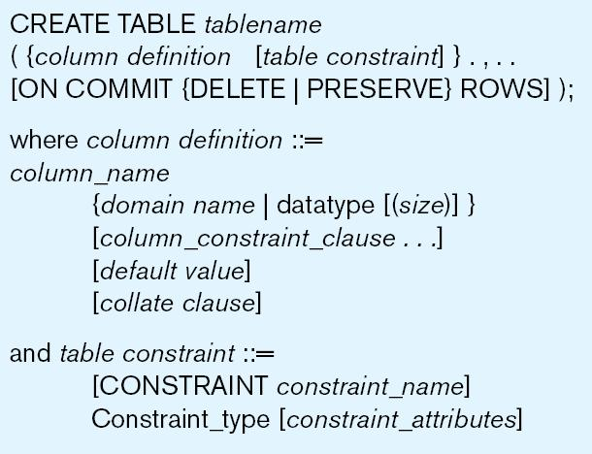
Figure 6-5 General syntax for CREATE TABLE statement used in data definition language

Slide 14
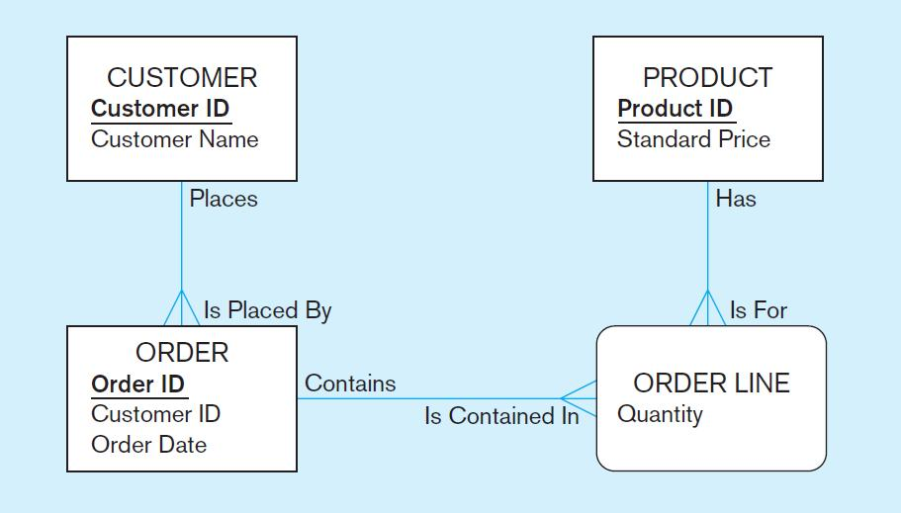
THE FOLLOWING SLIDES CREATE TABLES FOR THIS ENTERPRISE DATA MODEL
(from Chapter 1, Figure 1-3)

Slide 15
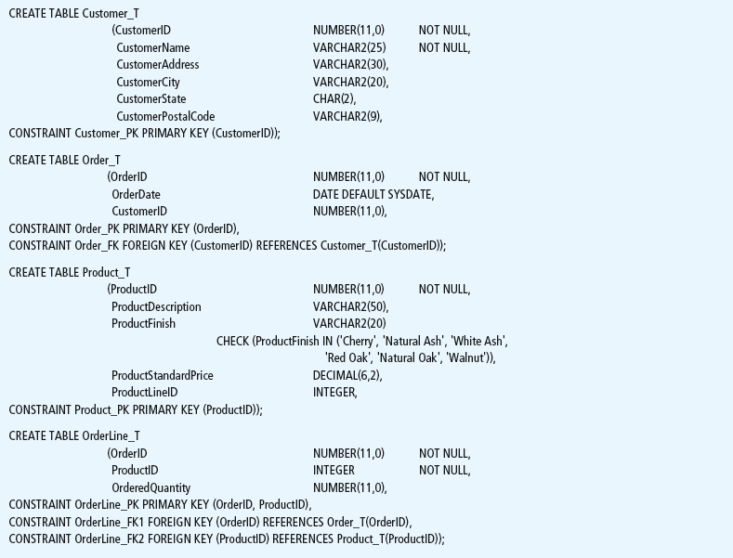
Figure 6-6 SQL database definition commands for Pine Valley Furniture Company (Oracle 11g)
Overall table definitions

Slide 16
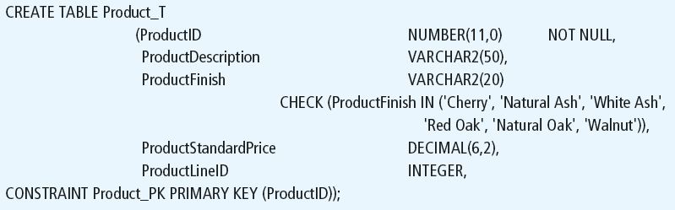
Defining attributes and their data types
Chapter 6
© 2013 Pearson Education, Inc. Publishing as Prentice Hall

Slide 17
Non-nullable specification
Primary keys can never have NULL values
Identifying primary key
Chapter 6
© 2013 Pearson Education, Inc. Publishing as Prentice Hall

Slide 18
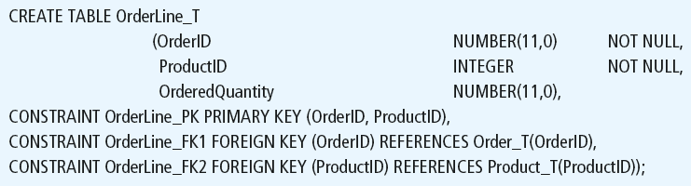
Non-nullable specifications
Primary key
Some primary keys are composite– composed of multiple attributes
Chapter 6
© 2013 Pearson Education, Inc. Publishing as Prentice Hall

Slide 19
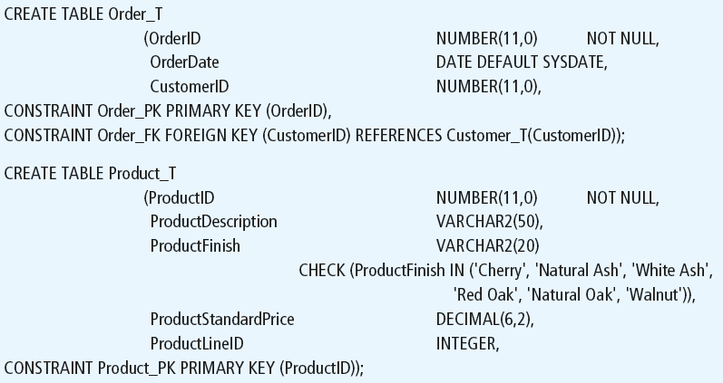
Controlling the values in attributes
Default value
Domain constraint
Chapter 6
© 2013 Pearson Education, Inc. Publishing as Prentice Hall

Slide 20
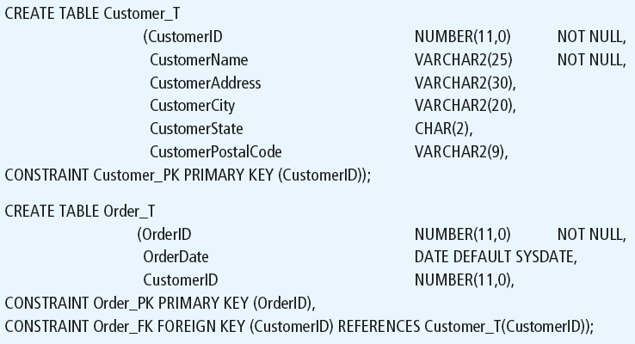
Identifying foreign keys and establishing relationships
Primary key of parent table
Foreign key of dependent table
Chapter 6
© 2013 Pearson Education, Inc. Publishing as Prentice Hall

Slide 21
DATA INTEGRITY CONTROLS
Referential integrity–constraint that ensures that foreign key values of a table must match primary key values of a related table in 1:M relationships
Restricting:
  Deletes of primary records
  Updates of primary records
  Inserts of dependent records

Slide 22
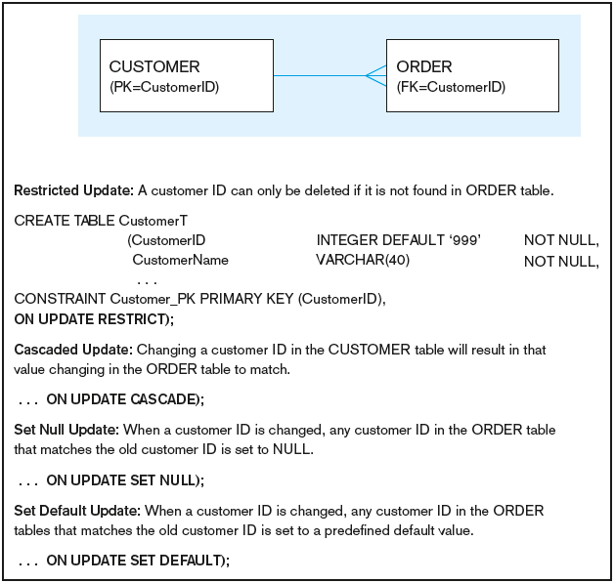
Figure 6-7 Ensuring data integrity through updates
Relational integrity is enforced via the primary-key to foreign-key match
Chapter 6
© 2013 Pearson Education, Inc. Publishing as Prentice Hall

Slide 23

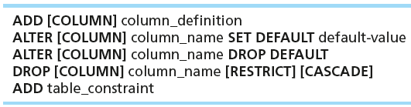

CHANGING TABLES
ALTER TABLE statement allows you to change column specifications:
Table Actions:
Example (adding a new column with a default value):

Slide 24
REMOVING TABLES
DROP TABLE statement allows you to remove tables from your schema:
  DROP TABLE CUSTOMER_T

Slide 25



INSERT STATEMENT
Adds one or more rows to a table
Inserting into a table
Inserting a record that has some null attributes requires identifying the fields that actually get data
Inserting from another table

Slide 26
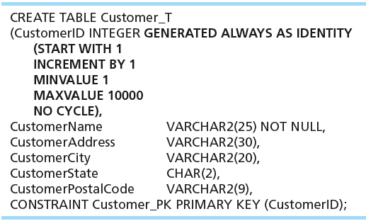
CREATING TABLES WITH IDENTITY COLUMNS
Introduced with SQL:2008
Inserting into a table does not require explicit customer ID entry or field list
  INSERT INTO CUSTOMER_T VALUES ( ‘Contemporary Casuals’, ‘1355 S. Himes Blvd.’, ‘Gainesville’, ‘FL’, 32601);

Slide 27
DELETE STATEMENT
Removes rows from a table
Delete certain rows
  DELETE FROM CUSTOMER_T WHERE CUSTOMERSTATE = ‘HI’;
Delete all rows
  DELETE FROM CUSTOMER_T;

Slide 28

UPDATE STATEMENT
Modifies data in existing rows

Slide 29
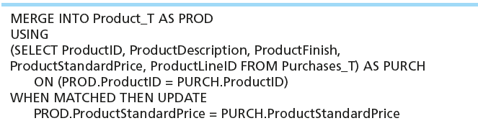
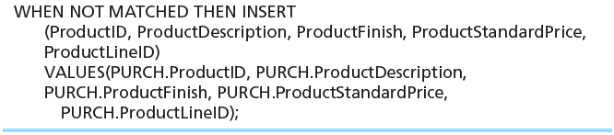
MERGE STATEMENT
Makes it easier to update a table…allows combination of Insert and Update in one statement
Useful for updating master tables with new data

Slide 30
SCHEMA DEFINITION
Control processing/storage efficiency:
  Choice of indexes
  File organizations for base tables
  File organizations for indexes
  Data clustering
  Statistics maintenance
Creating indexes
  Speed up random/sequential access to base table data
  Example
    CREATE INDEX NAME_IDX ON CUSTOMER_T(CUSTOMERNAME)
    This makes an index for the CUSTOMERNAME field of the CUSTOMER_T table

Slide 31
SELECT STATEMENT
Used for queries on single or multiple tables
Clauses of the SELECT statement:
  SELECT
    List the columns (and expressions) to be returned from the query
  FROM
    Indicate the table(s) or view(s) from which data will be obtained
  WHERE
    Indicate the conditions under which a row will be included in the result
  GROUP BY
    Indicate categorization of results
  HAVING
    Indicate the conditions under which a category (group) will be included
  ORDER BY
    Sorts the result according to specified criteria

Slide 32
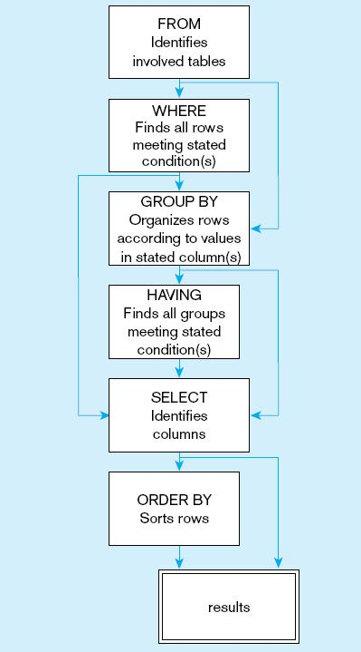
Figure 6-10
  SQL statement processing order (based on van der Lans, 2006 p.100)
Chapter 6
© 2013 Pearson Education, Inc. Publishing as Prentice Hall

Slide 33
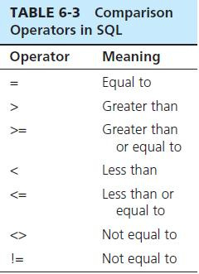

SELECT EXAMPLE
Find products with standard price less than $275
Table 6-3: Comparison Operators in SQL

Slide 34
SELECT EXAMPLE USING ALIAS
Alias is an alternative column or table name
    SELECT CUST.CUSTOMERNAME AS NAME, CUST.CUSTOMERADDRESS
    FROM CUSTOMER_V CUST
    WHERE NAME = ‘Home Furnishings’;

Slide 35
SELECT EXAMPLE USING A FUNCTION
Using the COUNT aggregate function to find totals
  SELECT COUNT(*) FROM ORDERLINE_T
  WHERE ORDERID = 1004;
  Note: With aggregate functions you can’t have single-valued columns included in the SELECT clause, unless they are included in the GROUP BY clause.

Slide 36
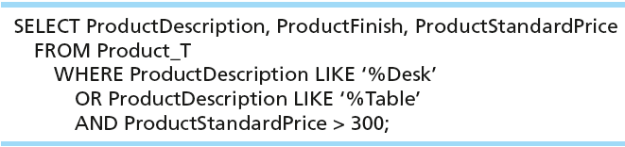
SELECT EXAMPLE–BOOLEAN OPERATORS
AND, OR, and NOT Operators for customizing conditions in WHERE clause
Note: The LIKE operator allows you to compare strings using wildcards. For example, the % wildcard in ‘%Desk’ indicates that all strings that have any number of characters preceding the word “Desk” will be allowed.

Slide 37
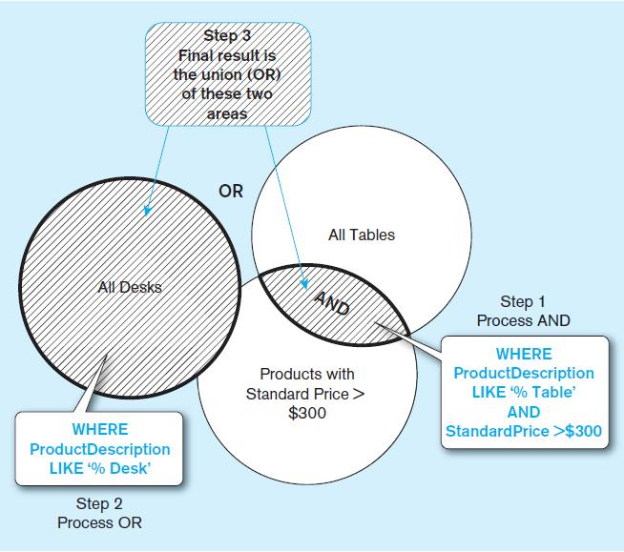
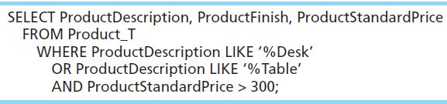
Figure 6-8 Boolean query A without use of parentheses
By default, processing order of Boolean operators is NOT, then AND, then OR

Slide 38
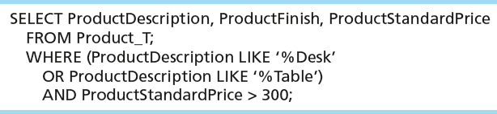
SELECT EXAMPLE–BOOLEAN OPERATORS
With parentheses…these override the normal precedence of Boolean operators
With parentheses, you can override normal precedence rules. In this case parentheses make the OR take place before the AND.

Slide 39
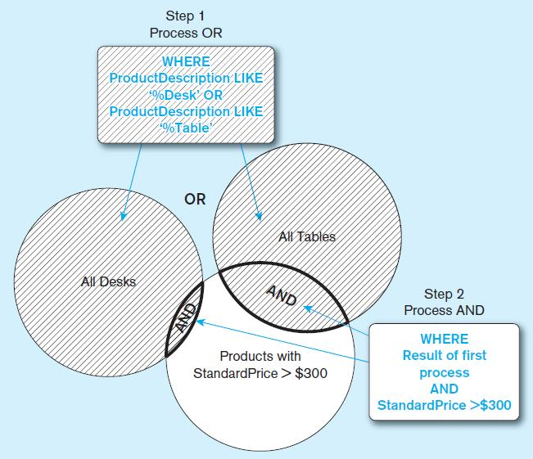
Figure 6-9 Boolean query B with use of parentheses

Slide 40
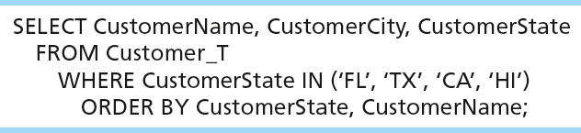
SORTING RESULTS WITH ORDER BY CLAUSE
Sort the results first by STATE, and within a state by the CUSTOMER NAME
Note: The IN operator in this example allows you to include rows whose CustomerState value is either FL, TX, CA, or HI. It is more efficient than separate OR conditions.

Slide 41

CATEGORIZING RESULTS USING GROUP BY CLAUSE
For use with aggregate functions
  Scalar aggregate: single value returned from SQL query with aggregate function
  Vector aggregate: multiple values returned from SQL query with aggregate function (via GROUP BY)
  You can use single-value fields with aggregate functions if they are included in the GROUP BY clause

Slide 42
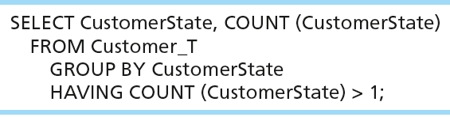
QUALIFYING RESULTS BY CATEGORIES
USING THE HAVING CLAUSE
For use with GROUP BY
Like a WHERE clause, but it operates on groups (categories), not on individual rows. Here, only those groups with total numbers greater than 1 will be included in final result.

Slide 43
USING AND DEFINING VIEWS
Views provide users controlled access to tables
Base Table–table containing the raw data
Dynamic View
  A “virtual table” created dynamically upon request by a user
  No data actually stored; instead data from base table made available to user
  Based on SQL SELECT statement on base tables or other views
Materialized View
  Copy or replication of data
  Data actually stored
  Must be refreshed periodically to match corresponding base tables

Slide 44
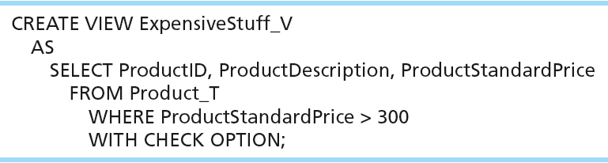
SAMPLE CREATE VIEW
View has a name.
View is based on a SELECT statement.
CHECK_OPTION works only for updateable views and prevents updates that would create rows not included in the view.

Slide 45
ADVANTAGES OF VIEWS
Simplify query commands
Assist with data security (but don't rely on views for security, there are more important security measures)
Enhance programming productivity
Contain most current base table data
Use little storage space
Provide customized view for user
Establish physical data independence

Slide 46
DISADVANTAGES OF VIEWS
Use processing time each time view is referenced
May or may not be directly updateable

Slide 47

Copyright © 2013 Pearson Education, Inc. Publishing as Prentice Hall

